Slide 1

INFRASTRUCTURE SOLUTIONS OF CLOUD
Module Number: 05
Module Name: Implementing Websites In Azure

Slide 2
Syllabus:
Implementing Websites In Azure
Creating an azure websites
Configuring site settings
Configuring custom domain for a website
Configuring SSL certificates for an azure website
Configuring azure traffic manager
Creating a new web hosting plan
Creating a website within existing web hosting plan
Migrating websites between hosting plans

Slide 3
Implementing Websites In Azure
Aim:
To equip the students to Implement and Manage Websites in AZURE

Slide 4
Implementing Websites In Azure
Objectives:
The Objectives of this module are:
Differentiate the various Azure Services
Deploy synchronization pattern on Azure Apps.
Modify a API permission in Azure Apps
Design native web application with azure
Implement a Monitoring service for Websites in Azure

Slide 5
Implementing Websites in Azure
Outcomes:
At the end of this module, you are expected to:
Compare the Component in Azure App Services
Design synchronization pattern on Azure App
Apply the control AD in For azure App
Create appropriate Monitoring cloud service in Azure Websites in Azure

Slide 6
Table of Contents
Implementing Websites in Azure
Creating an azure websites
Configuring site settings
Configuring custom domain for a website
Configuring SSL certificates for an azure website
Configuring azure traffic manager
Creating a new web hosting plan
Creating a website within existing web hosting plan
Migrating websites between hosting plans

Slide 7
Implementing Websites in Azure
Creating an azure websites
In the chapter titled "Implementing Websites in Azure," there is a comprehensive explanation of how to build websites in Azure. Be careful not to become confused because the management portal refers to the Azure websites service as "Web Apps" everywhere. We'll go over a few more terms related to Azure websites in this chapter. When deploying their websites to a hosting environment, developers frequently run into issues. The Azure websites service makes ensuring that website creators have as few issues as possible when launching their websites. The Azure website service is also a PaaS. (Platform as a Service). This implies that websites can be launched even without a true infrastructure.

Slide 8
Implementing Websites In Azure
Creating an azure websites
Create a Website in Azure Management Portal
Just to reconnect with the website creation, let’s take a look at these steps of how to create a website in Azure Management portal.
Step 1 − Login to your management portal.
Step 2 − Click ‘New’ at the left bottom corner of the screen → Compute → Web Apps → Quick Create.

Slide 9
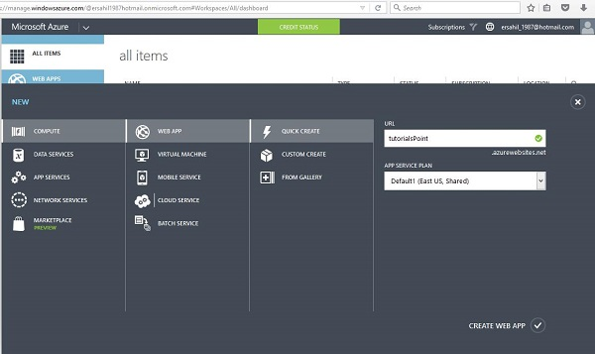
Implementing Websites in Azure
Creating an azure websites
Source:https://www.tutorialspoint.com/microsoft_azure/microsoft_azure_websites.htm#:~:text=Create%20a%20Website%20in%20Azure%20Management%20Portal&text=Step%201%20%E2%88%92%20Login%20to%20your,click%20'Create%20Web%20App'.

Slide 10
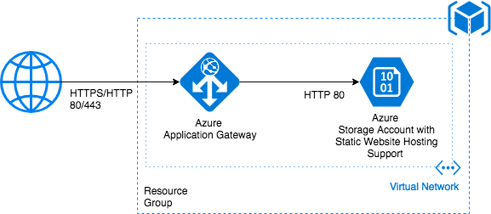
Implementing Websites in Azure
Creating an azure websites
Step 3 − Enter the details as shown in the picture above and click ‘Create Web App’.
Step 4 − Go back to websites in your management portal and you will see it listed. Click the URL.
Source: https://medium.com/@emin.askerov/static-website-hosting-in-azure-storage-with-custom-domain-and-ssl-support-using-azure-application-b17f95c6764c

Slide 11
Implementing Websites in Azure
Configuring site settings
A solution to manage application settings and feature flags centrally is offered by Azure App Configuration.
Modern applications, especially those that operate in the cloud, frequently have a large number of dispersed components.
When deploying an application, issues may occur that are difficult to troubleshoot if configuration parameters are dispersed throughout these components.
Use App Configuration to centrally store and protect all of your application's settings.

Slide 12
Implementing Websites in Azure
Configuring site settings
Cloud-based apps frequently leverage various external services and run on numerous virtual machines or containers across numerous geographic locations. A big problem is constructing a reliable and expandable application in a distributed environment.
Developers are assisted by a variety of programming approaches in managing the growing complexity of creating apps. For instance, several tried-and-true architectural patterns and best practices for use with cloud applications are described in the Twelve-Factor App.
Separating setup from code is one of this guide's main recommendations. The configuration options for a programme should be kept separate from its executable and loaded from the runtime environment or another external source.

Slide 13
Implementing Websites in Azure
Configuring site settings
Any programmer can use App Configuration, however the types of applications that gain the most from its use are those listed below:
Microservices deployed in one or more locations that use Azure Service Fabric, Azure Kubernetes Service, or other containerized apps Azure Functions and other event-driven stateless compute apps fall under the category of serverless applications. pipeline for continuous deployment

Slide 14
Implementing Websites in Azure
Configuring site settings
Managing Application Settings for an Azure App Service Web App can be performed using the Azure Portal. This provides an easy to use, graphical interface for configuring the Application Settings for an application hosting in Azure App Service.
Here are the necessary steps to locate and access the App Settings for an Azure Web App:
Open the Azure Portal at https://portal.azure.com
Navigate to your Azure App Service Web App.
Under Settings open up the Configuration option
The Application settings section can be used to manage the settings for the application.

Slide 15
Implementing Websites in Azure
Configuring custom domain for a website
You can point a different domain name to your website if you choose; Azure Static Web Apps automatically generates one for you.
For the automatically generated domain name and any additional custom domains you may add, free SSL/TLS certificates are automatically generated.
There are a few options open to you when you map a custom domain to a static web app. An apex domain as well as subdomains can be configured.

Slide 16
Implementing Websites in Azure
Configuring custom domain for a website
You'll come across the following words as you set up a custom domain.
Domains with an apex or root: For the domain www.example.com, the www prefix is referred to as the subdomain, while the remainder of example.com is referred to as the apex domain.
Domain registrar: A registrar sells the rights to buy a domain name and ensures that it is available.
A DNS zone is where a domain's DNS records are stored in the Domain Name System (DNS). Different records are accessible that guide traffic for diverse objectives.
The domain example.com, for instance, might have a number of DNS records. For a mail server, one record handles traffic for mail.example.com. another for www.contoso.com (for a website).

Slide 17
Implementing Websites in Azure
Configuring custom domain for a website
Make your environment ready.
Use an app you made for another instruction or create one using the App Service. The web app must have an App Service plan that is a paid tier, not a free one (F1). See Update the tier by scaling up the app.
To change the DNS records for your custom domain, confirm that you can. You must have access to your domain registrar's DNS registry, such as GoDaddy, in order to update DNS records.
You must be able to set up the DNS settings for the contoso.com root domain, for instance, in order to create DNS entries for contoso.com and www.contoso.com. Your custom domains must be in a public DNS zone; internal load balancer (ILB) app service environments only support private DNS zones (ASE).

Slide 18
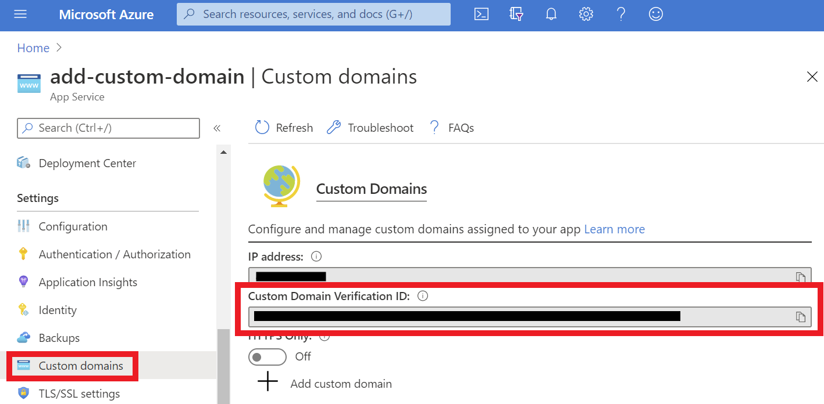
Implementing Websites in Azure
Configuring custom domain for a website
Source: https://docs.microsoft.com/en-us/azure/app-service/app-service-web-tutorial-custom-domain?tabs=a%2Cazurecli

Slide 19
Implementing Websites in Azure
Configuring SSL certificates for an azure website
A highly scalable, self-patching web hosting service is offered by Azure App Service. You can create, upload, or import a private certificate or a public certificate into App Service.
You can secure a unique DNS name with the certificate once it has been added to your App Service app or function app, or you can utilize it in your application code.
A deployment unit associated with the resource group, region, and operating system combinations of the app service plan stores a certificate that has been uploaded into the app (internally called a webspace). Other apps in the same resource group and region combination can now access the certificate.

Slide 20
Implementing Websites in Azure
Configuring SSL certificates for an azure website
Private certificate requirements
The free App Service managed certificate and the App Service certificate already satisfy the requirements of App Service. If you choose to upload or import a private certificate to App Service, your certificate must meet the following requirements:
Exported as a password-protected PFX file, encrypted using triple DES.
Contains private key at least 2048 bits long
Contains all intermediate certificates and the root certificate in the certificate chain.
To secure a custom domain in a TLS binding, the certificate has additional requirements:
Contains an Extended Key Usage for server authentication (OID = 1.3.6.1.5.5.7.3.1)
Signed by a trusted certificate authority

Slide 21
Implementing Websites in Azure
Configuring SSL certificates for an azure website
Import an App Service Certificate
If you purchase an App Service Certificate from Azure, Azure manages the following tasks:
Takes care of the purchase process from GoDaddy.
Performs domain verification of the certificate.
Maintains the certificate in Azure Key Vault.
Manages certificate renewal (see Renew certificate).
Synchronize the certificate automatically with the imported copies in App Service apps.

Slide 22
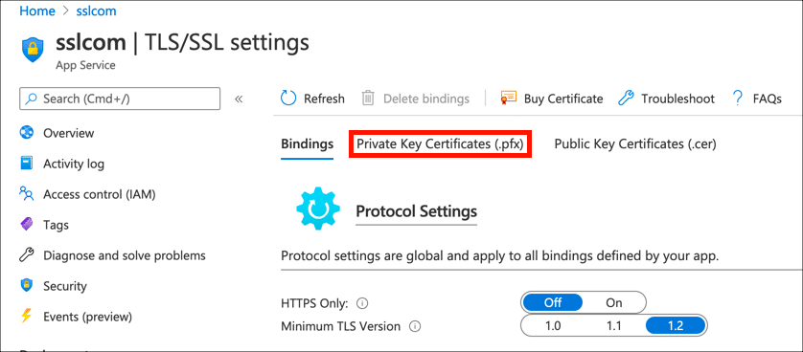
Implementing Websites in Azure
Configuring SSL certificates for an azure website
Source: https://www.ssl.com/how-to/install-ssl-tls-certificate-microsoft-azure-app-service-web-apps/

Slide 23
Implementing Websites in Azure
Configuring azure traffic manager
To decide how to direct network traffic to the various service endpoints, Azure Traffic Manager provides six traffic-routing techniques.
Each DNS query received by Traffic Manager is subject to the traffic-routing strategy associated with the profile to which it belongs.
Which endpoint is returned in the DNS response is determined by the traffic-routing technique.

Slide 24
Implementing Websites in Azure
Configuring azure traffic manager
The following traffic routing methods are available in Traffic Manager:
Priority routing. In the event that the primary endpoint or one of the backup endpoints is down, you can offer numerous backup endpoints.
When you want to divide traffic among a group of endpoints according to their weight, choose weighted routing. To spread the weight equally among all endpoints, set it to 1.
When you have endpoints spread out geographically and want end users to use the "closest" endpoint for the shortest network latency, choose performance routing.

Slide 25
Implementing Websites in Azure
Configuring azure traffic manager
Health monitoring and endpoint failover are features shared by all Traffic Manager profiles. Visit Traffic Manager Endpoint Monitoring for additional details.
You can only set up one traffic routing technique at a time in a Traffic Manager profile. For your profile, you can change the traffic routing mechanism whenever you want.
Your modifications will be implemented instantly, without any downtime. Utilizing nested Traffic Manager profiles, you may mix traffic routing strategies.
Nesting profiles enable complicated traffic-routing setups that satisfy the requirements of more demanding and intricate applications. See nested Traffic Manager profiles for further details.

Slide 26
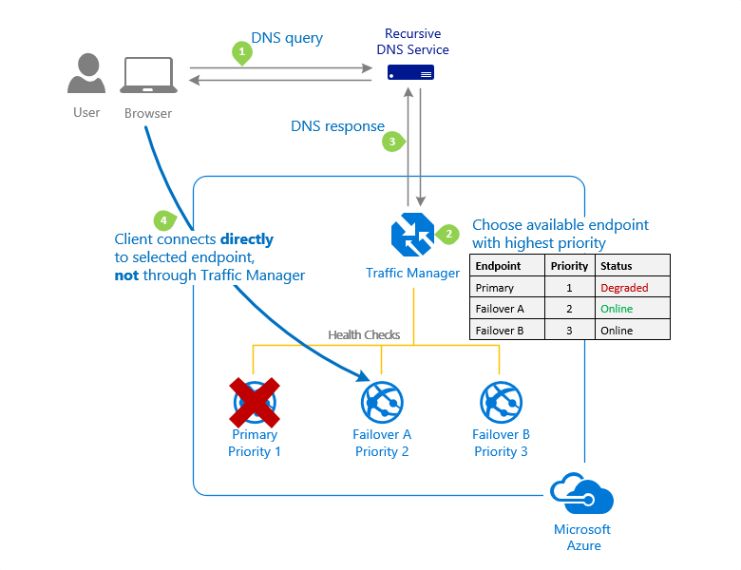
Implementing Websites in Azure
Configuring azure traffic manager
Priority traffic-routing method
Often an organization wants to provide reliability for their services. To do so, they deploy one or more backup services in case their primary goes down. The 'Priority' traffic-routing method allows Azure customers to easily implement this failover pattern.
Source: https://docs.microsoft.com/en-us/azure/traffic-manager/traffic-manager-routing-methods

Slide 27
Implementing Websites in Azure
Creating a new web hosting plan
When you build a new website using the administration portal, you can create a new web hosting plan. Select the desired web hosting plan by clicking the Web Hosting Plan setting in the new Website blade.
The Pricing tier blade does an excellent job of outlining all the many web hosting plans that are offered, their feature distinctions, and even the approximate monthly costs for each plan.
Give the web hosting plan a name after choosing the one you like, and it will be saved as you go with building the website.

Slide 28
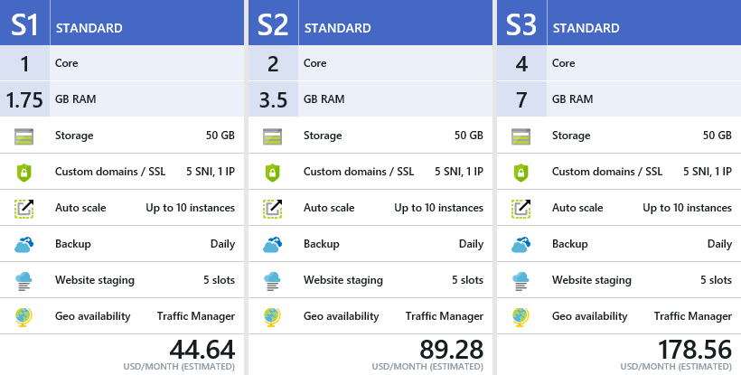
Implementing Websites in Azure
Creating a new web hosting plan
Source: https://i1.wp.com/www.techveze.com/wp-content/uploads/2018/07/new-web-hosting-plan-1.png?ssl=1

Slide 29
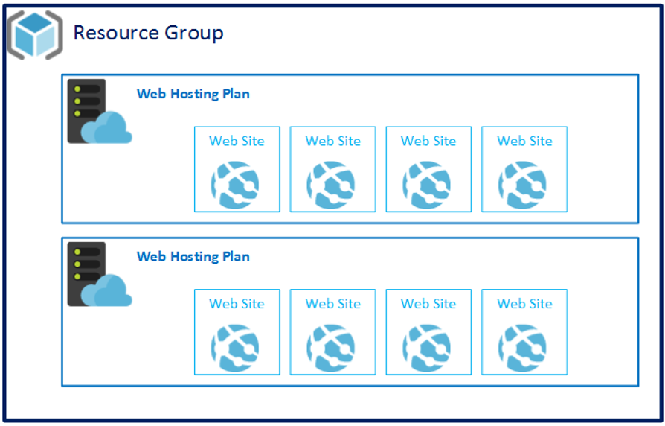
Implementing Websites in Azure
Creating a new web hosting plan
How to host multiple websites on a Standard Azure Websites Instance?
Source: https://stackoverflow.com/questions/25675461/how-to-host-multiple-websites-on-a-standard-azure-websites-instance-is-this-a-w

Slide 30
Implementing Websites in Azure
Creating a new web hosting plan
Publish website online
Either utilizing Visual Studio web deployment or a straightforward copy action in the remote desktop, you can publish a website.
An ASP.NET web application can be easily published using the Microsoft Azure Virtual Machines publishing capability in Visual Studio 2019.
It should be mentioned that the virtual machine must have Web Deploy installed on it and should be set up to run ASP.NET web apps.

Slide 31
Implementing Websites in Azure
Creating a new web hosting plan
Bind A Domain with Public IP Address
Once you have confirmed that external users can access the website, you can attach a domain name to the public IP address to simplify access to the site for external users.
You can add the public IP address of the website to the domain you own by modifying the Domain Name System (DNS) record with the registrar.

Slide 32
Implementing Websites in Azure
Creating a website within existing web hosting plan
Azure When building a new website, you have the option of building it within an existing web hosting plan. This is referred to as website creation and migration within an existing hosting plan.
To do this, select one of your current plans by clicking the Web Hosting Plan setting. It may make sense to move your website to a new web hosting plan that offers the capacity and capabilities required, as opposed to moving websites between hosting plans, which addresses the case when your website's requirements change.
Open the Website blade for the website you wish to switch to a different plan on in order to accomplish this. Figure 1 depicts the Web Hosting Plan toolbar button at the top of the blade, which when clicked, will enable

Slide 33
Implementing Websites in Azure
Creating a website within existing web hosting plan
When migrating a website to a different web host, you need to:
Purchase and activate a new web hosting accounts,
Move all website files – including databases and email accounts,
Install and configure your application at the new host,
Check new site on staging / temporary URL,
Troubleshoot if any errors, and
Point your domain DNS records to the new web host

Slide 34
Implementing Websites in Azure
Migrating websites between hosting plans
Large commercial IT environments with strict compliance and data protection needs can benefit greatly from Azure's strong cloud platform.
The advantages and disadvantages of the four main migration strategies—
Rehost, Refactor, Rearchitect, and Rebuild—should be taken into account while planning your migration.
Your entire Azure migration plan will be determined by which of these models you choose.

Slide 35
Implementing Websites in Azure
Migrating websites between hosting plans
Your current websites that use Internet Information Service (IIS) 6 or later can now be simply transferred to Azure Websites.
With just a few clicks, you can migrate your websites and associated databases to Azure using the Azure Websites Migration Assistant, which can analyse your IIS server installation, identify which sites can be migrated to Azure Websites, highlight any elements that cannot be migrated or are not supported on the platform.

Slide 36
Implementing Websites in Azure
Migrating websites between hosting plans
Moving your DNN site to the cloud in 3 steps
To start the process, you will need to browse https://www.movemetothecloud.net and follow the instructions. The migration process has 3 steps:
1. Install the Migration Assistant tool (available at https://www.movemetothecloud.net/)
2. Run the readiness assessment
3. Migrate your site(s) (hey! You can move more than one site at time!)
The website I used for this test was a DNN Platform 7.3.4 default installation. Before starting the assistant I double checked that the site was working fine (see tips and tricks section to save time on known issues).

Slide 37
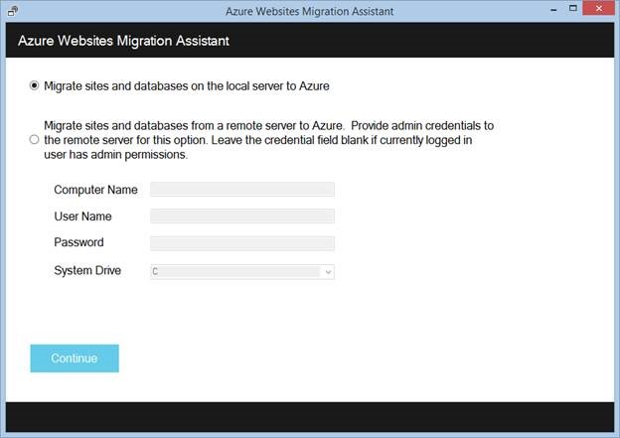
Implementing Websites in Azure
Migrating websites between hosting plans
So after downloading the assistant the first screen appears to ask for the on premise IIS server hosting the website to migrate. Since mine was my own laptop, I used the default option:
Source : https://geeks.ms/davidjrh/2015/01/16/using-the-azure-websites-migration-assistant-to-migrate-a-dnn-website/

Slide 38
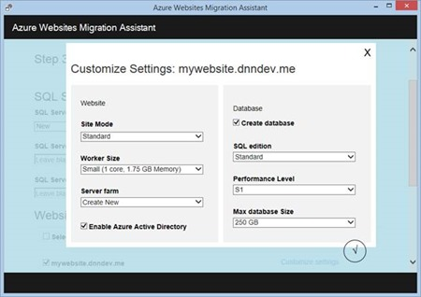
Implementing Websites in Azure
Migrating websites between hosting plans
By clicking on the Customize settings link, you can also choose the website mode, the worker size, the web hosting plan (server farm) as well as the database edition. You can just use the defaults, but by my experience I would recommend at least a S1 database edition for performance reasons.
Source : https://geeks.ms/davidjrh/2015/01/16/using-the-azure-websites-migration-assistant-to-migrate-a-dnn-website/

Slide 39
Implementing Websites in Azure
Migrating websites between hosting plans
Therefore, I strongly advise you to confirm that the database is SQL Database compatible before executing the Azure Websites Migration Helper if you intend to relocate a website that depends on a database, such as DNN. There are numerous ways to achieve that goal; here are some ideas:
1) Use the SSMS database migration wizard targeting a SQL Database as destination. I believe a similar process is used under the covers
2) Use the always free SQL Azure Migration wizard available at CodePlex
3) Use RedGate’s SQL Compare, my favorite! Check here for a free trial

Slide 40

Implementing Websites in Azure
Summary
In this module, we have studied Implementing Websites in Azure, The Azure websites service makes ensuring that website creators have as few issues as possible when launching their websites. The Azure website service is also a PaaS. (Platform as a Service). This implies that websites can be launched even without a true infrastructure.
A deployment unit associated with the resource group, region, and operating system combinations of the app service plan stores a certificate that has been uploaded into the app (internally called a webspace).
Nesting profiles enable complicated traffic-routing setups that satisfy the requirements of more demanding and intricate applications. See nested Traffic Manager profiles for further details.

Slide 41
Implementing Websites in Azure
Self Assessment ( Quiz)
Q1. Which of the following web applications can be deployed with Azure?
PHP
ASP.NET
WCF
All of the above
Answer: d

Slide 42
Implementing Websites in Azure
Q2. A _________ role is a virtual machine instance running the Microsoft IIS Web server that can accept and respond to HTTP or HTTPS requests.
EC2
S3
EC3
All of the mentioned
Answer: b

Slide 43
Implementing Websites in Azure
Q3. Which service in Azure is used to manage resources in Azure?
Azure Resource Manager
Application Insights
Log Analytics
Azure Portal
Answer: d)

Slide 44
Implementing Websites in Azure
Q4. Customers Should Deploy Azure Resources To Multiple Regions To Ensure
cost reduction.
availability.
scalability.
none
Answer: b)

Slide 45
Implementing Websites in Azure
Q5. Azure App/logic App is a technology created by ..................
Microsoft
IBM
Google
None Of The Above
Answer: a

Slide 46
Implementing Websites in Azure
Q6. The technology used to distribute service requests to resources is referred to as _____________
Load Scheduling
Load Performing
Load Balancing
None
Answer: c

Slide 47
Implementing Websites in Azure
Q7. When planning to migrate a public website to Azure, you must plan to pay monthly usage costs.
No change is needed
Deploy a VPN
pay to transfer all the website data to Azure
reduce the number of connections to the website
Answer- a)

Slide 48
Implementing Websites in Azure
Q8. Which Azure Management Tool Analyzes Resources And Provides Recommendations To Optimize Deployments?
Azure Advisor
Azure Recommend
Azure Proactive
Azure Optimize
Answer: a)

Slide 49
Implementing Websites in Azure
Q9. Which load balancer operates at both individual request level (Layer 7) and connection level (Layer 4) only?
(a) Application Load Balancers
(b) Network Load Balancers
(c) Storage Load Balancers
(d) Classic Load Balancers
Answer: d

Slide 50
Implementing Websites in Azure
Q10. Major Components of Active Directory are ................
Tree
Site
Domain
All of the above
Answer: d

Slide 51

Implementing Websites in Azure
Activity
Activity Type: Offline Duration: 60 Minutes
Description: Case Study: Adding Application Insights to a website

Slide 52

Implementing Websites in Azure
Subjective Assessment
What are the main functions of the Azure App service?
Give a clear overview of API in Implementing Static and Dynamic Websites.
What are the benefits of the traffic manager in Windows Azure?

Slide 53

Implementing Websites in Azure
External Resources
https://azure.microsoft.com/en-us/resources/whitepapers/developer-guide-to-azure/
https://www.hostinger.in/tutorials/how-to-host-a-website

Slide 54
Implementing Websites in Azure
Document Links
Topics | URL | Notes
AZURE App Services | https://azure.microsoft.com/en-in/services/app-service/ | This link explain AZURE App Services
Azure Website Migration | https://azure.microsoft.com/en-us/services/app-service/migration-tools/ | This link explains Azure Website Migration

Slide 55
Implementing Websites in Azure
Video Links
Topics | URL | Notes
AZURE App Services | https://www.youtube.com/watch?v=x6JXqDKRjos | This video explains AZURE App Services
Azure Website Migration | https://www.youtube.com/watch?v=Hf7ZTa_PlGU | You will learn Azure Website Migration
Monitoring service for Websites in Azure | https://www.youtube.com/watch?v=CnQ1oKXc26Y | This video explains Monitoring service for Websites in Azure

Slide 56
Implementing Websites in Azure
E-Book Links
Topics | URL | Page Number
Implementing Websites in Azure | https://download.microsoft.com/download/8/F/4/8F485F6E-EA78-43B5-84DE-1392EAB13779/Microsoft_Press_eBook_Building_Cloud_Apps_with%20Microsoft_Azure_PDF.pdf | All pages

